Slide 1



Starting Now
Beyond XGBoost - The Early Days of Tabular AI
Tabular data is challenging, but cutting-edge solutions like TabPFN and CARTE might change that?
Luca Massaron
Best-selling author 2x Kaggle Grandmaster

Slide 2

Beyond XGBoost
The Early Days of Tabular AI

Slide 3
About Luca Massaron
Having joined Kaggle over 10 years ago, Luca Massaron is a 2x Kaggle Grandmaster in competitions and notebooks. In Kaggle competitions, he reached no. 7 in the worldwide rankings.
On the professional side, Luca is a data scientist with more than a decade of experience in transforming data into smarter artifacts, solving real-world problems, and generating value for businesses and stakeholders.
He is a Google Developer Expert (GDE) in AI, Kaggle and Cloud
Author of best-selling books on AI, machine learning, and algorithms for Packt, Wiley, Manning.
Luca Massaron
Kaggle 2x Grandmaster

Slide 4
Agenda
01
The prologue
02
The breakthroughs
03
The new stuff
04
Benchmarking
05
Summing up
06
Q&A and thanks

Slide 5
Section [01]: The prologue

Slide 6
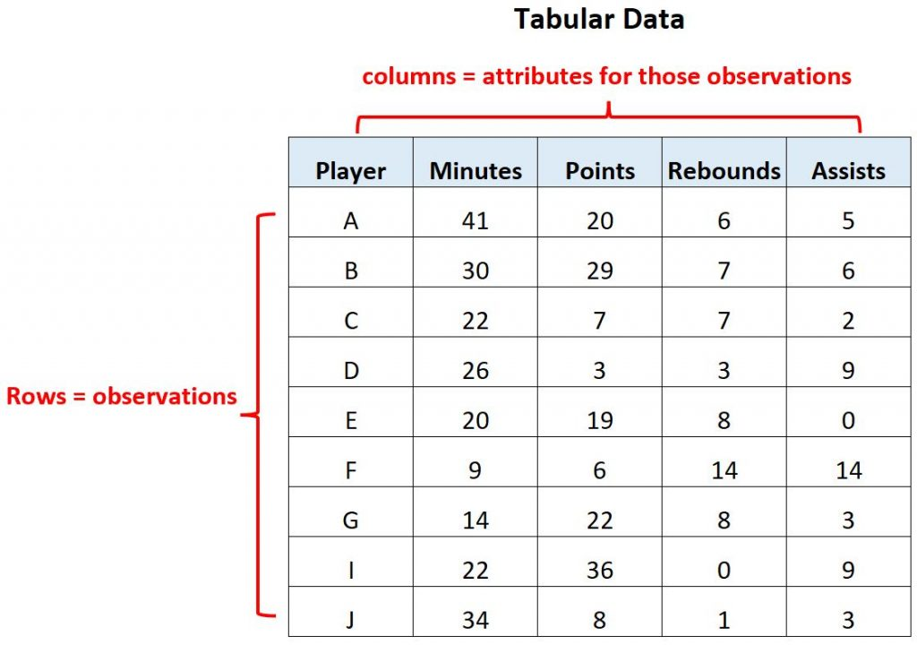
The prologue
Tabular Data
What is Tabular Data?
Data structured in rows and columns.
The realm of relational databases, Excel spreadsheets, and CSV files.
The most common and richest source of enterprise data.
What is it used for?
Predictions/Forecasts: demand forecasting, pricing estimates.
Classification/Clustering: Customer churn, Fraud detection, customer segmentation, product recommendations.
>
Pg: 6

Slide 7
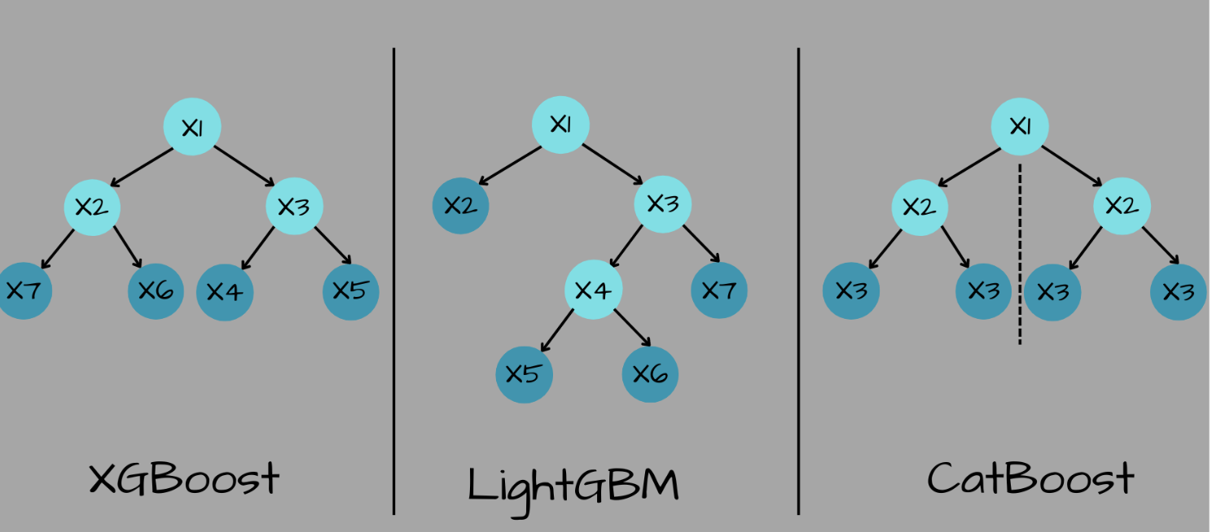
The prologue
The Pre-Deep Learning Status Quo
The Dominance of "Classical" Machine Learning
For years, Deep Learning models failed to outperform traditional methods on tabular data.
Kings of the Hill: Tree-based models. XGBoost | LightGBM | CatBoost
Core Frameworks:
Scikit-learn (79M+ monthly downloads)
Numpy, Pandas
XGBoost, LightGBM, CatBoost
>
Pg: 7

Slide 8
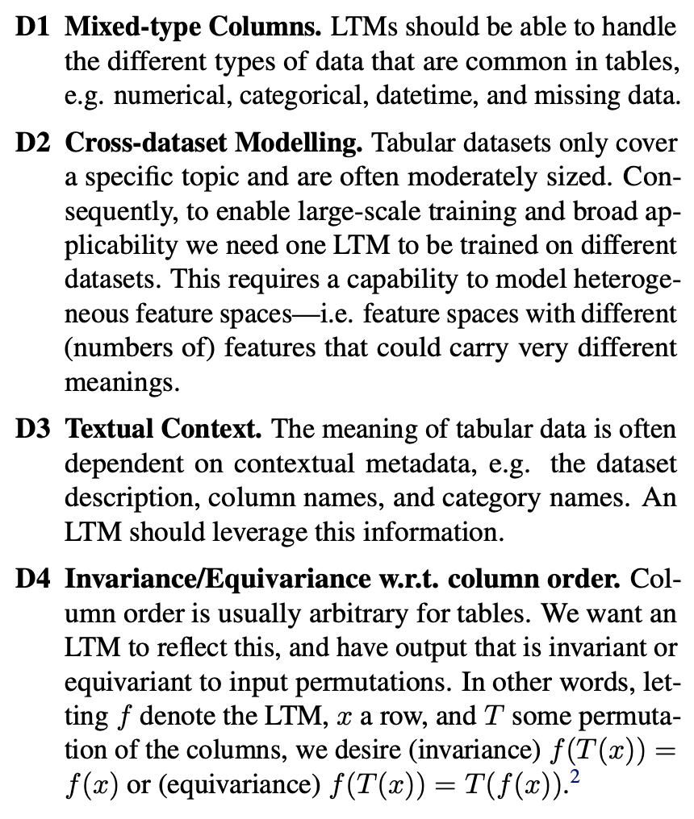
The prologue
Early Deep Learning Attempts for Tabular Data
Why Did Deep Learning Struggle?
Tabular data contains heterogeneous features (a mix of numbers, categories, text) and complex, non-linear relationships that standard neural networks couldn't easily capture.
Early Attempts (2019-2022):
TabNet (Google, 2019): Used a sequential attention mechanism to select features.
TabTransformer (Amazon, 2020): Applied transformer-style self-attention to the embeddings of categorical features.
Conclusion: While innovative, these models did not consistently surpass traditional gradient boosting methods.
Van Breugel, Boris, and Mihaela Van Der Schaar. "Why tabular foundation models should be a research priority." arXiv preprint arXiv:2405.01147 (2024).
>
Pg: 8

Slide 9



The prologue
The Rise of Tabular Foundation Models
A recent "Cambrian Explosion" in research for tabular-specific foundation models
CARTE TabICL
TabPFN v1 & v2
TabDPT
>
Pg: 9

Slide 10
Section [02]: The breakthroughs

Slide 11
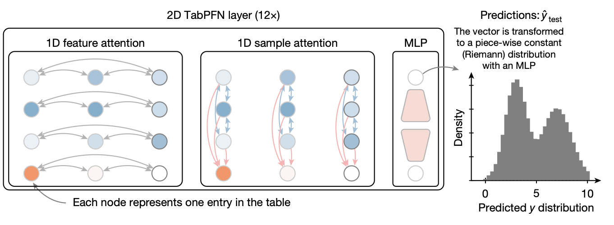
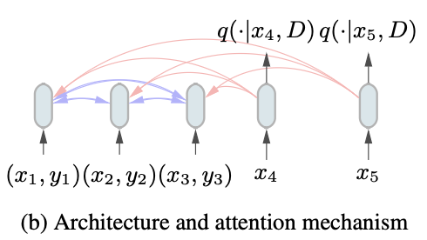
The breakthroughs
Breakthrough 1: TabPFN
TabPFN (Prior-Data Fitted Network)
Source: University of Freiburg, Germany (June 2023).
The Core Idea: A paradigm shift in training.
Instead of training on real-world data, a transformer was pre-trained on millions of synthetically generated tables.
This allows the model to learn the "Platonic ideal" of tabular data structures and relationships.
Result: A model that performs inference in a single forward pass, making predictions instantly without fine-tuning.
Architecture PFNs rely on a Transformer (Vaswani et al., 2017) that encodes each feature vector and label as a token, allowing token representations to attend to each other, as depicted in Figure 1b.
They accept a variable length training set Dtrain of feature and label vectors (treated as a set-valued input to exploit permutation invariance) as well as a variable length query set of feature vectors xtest = {x(test,1),...,x(test,m)}and return estimates of the PPD for each query.
>
Pg: 11

Slide 12
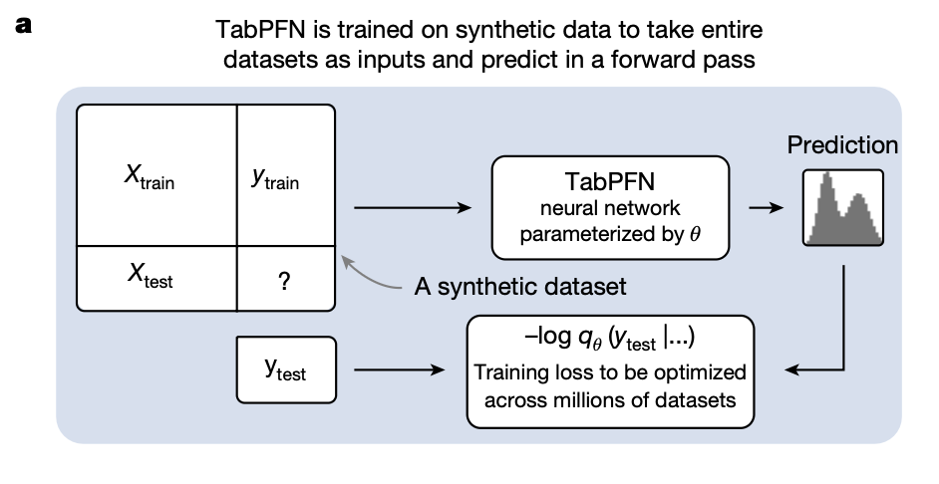
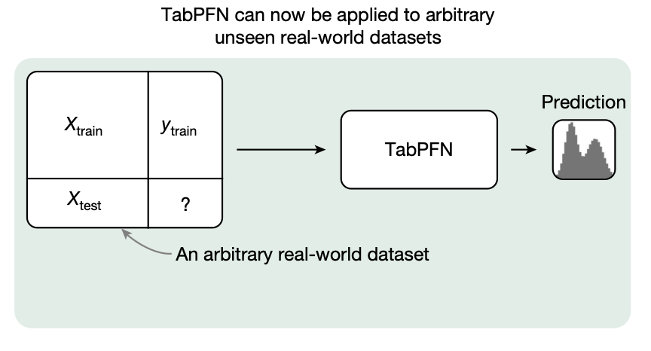
The breakthroughs
TabPFN's Evolution and Commercialization
TabPFN v2 (Jan 2025)
Published in Nature.
Expanded capabilities to handle categorical and textual features.
Scaled to larger datasets (up to 10,000 samples).
From Lab to Startup: Prior Labs
Led by AutoML pioneer Prof. Frank Hutter.
Raised €9M in pre-seed funding to commercialize the research.
>
Pg: 12

Slide 13
The breakthroughs
TabPFN's Impact and Performance
State-of-the-Art Performance on Small Data
Outperforms traditional ML models on datasets with ≤ 1000 rows and ≤ 100 features.
Incredible Speed
230x faster than AutoML pipelines.
5700x faster when run on a GPU.
High Efficiency
Can match the performance of benchmarks that take hours to compute, even when trained on only 50% of the data.
Limitations of TabPFN
TabPFN's inference speed may be slower than highly optimized approaches like CatBoost.
TabPFN's memory usage scales linearly with dataset size, which can be prohibitive for very large datasets.
Our evaluation focused on datasets with up to 10,000 samples and 500 features; scalability to larger datasets requires further study.
>
Pg: 13

Slide 14
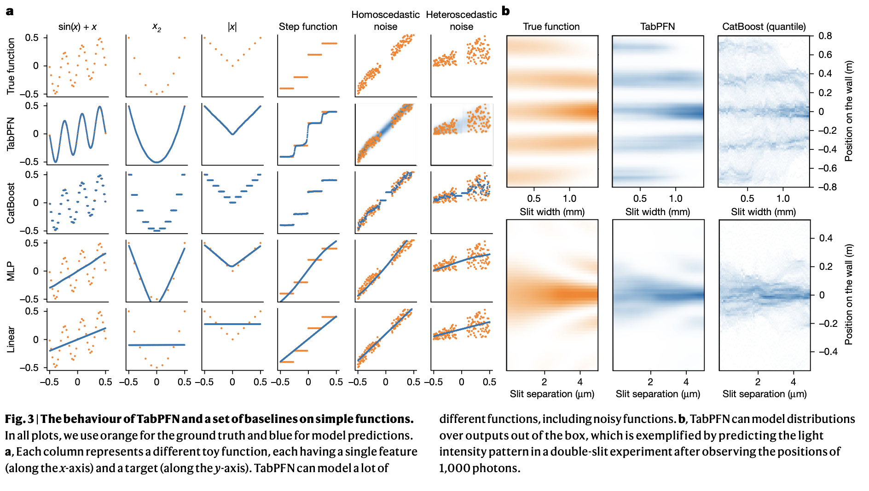
The breakthroughs
TabPFN's Impact and Performance
>
Pg: 14

Slide 15
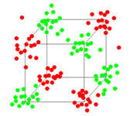
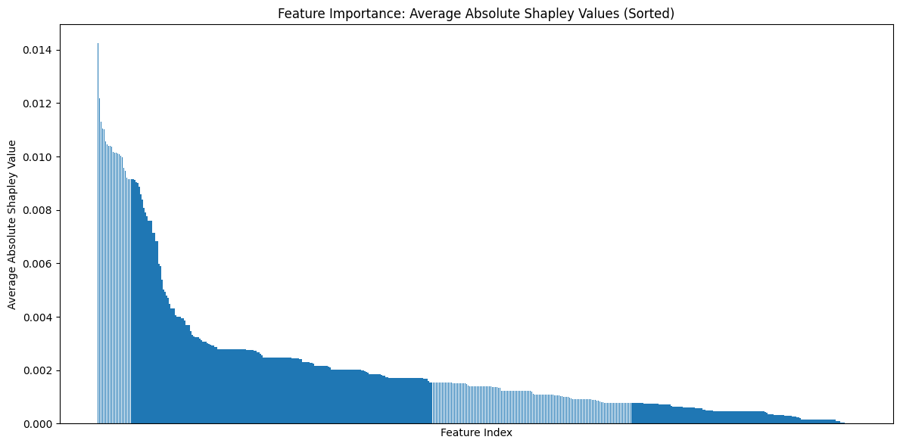
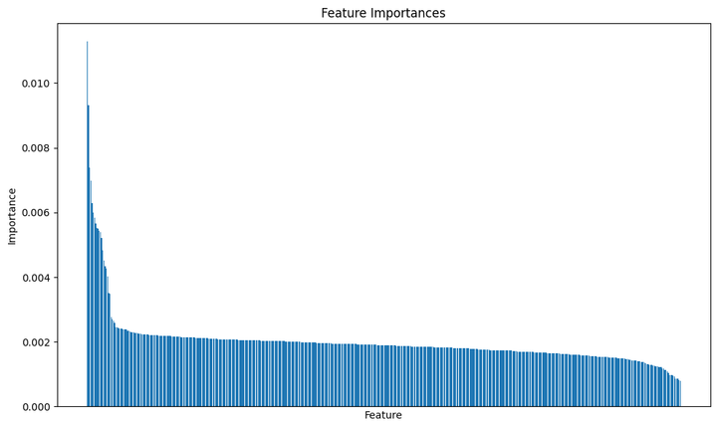
The breakthroughs
Vibe testing TabPFN
MADELON is an artificial dataset, which was part of the NIPS 2003 feature selection challenge. This is a two-class classification problem with continuous input variables. The difficulty is that the problem is multivariate and highly non-linear.
MADELON is an artificial dataset containing data points grouped in 32 clusters placed on the vertices of a five dimensional hypercube and randomly labeled +1 or -1. The five dimensions constitute 5 informative features. 15 linear combinations of those features were added to form a set of 20 (redundant) informative features. Based on those 20 features one must separate the examples into the 2 classes (corresponding to the +-1 labels). We added a number of distractor feature called 'probes' having no predictive power. The order of the features and patterns were randomized.
TABPFN
AUC-ROC: 0.905
Accuracy: 0.84
ROC AUC: 0.954
Accuracy 0.892
XGBOOST
>
Pg: 15

Slide 16
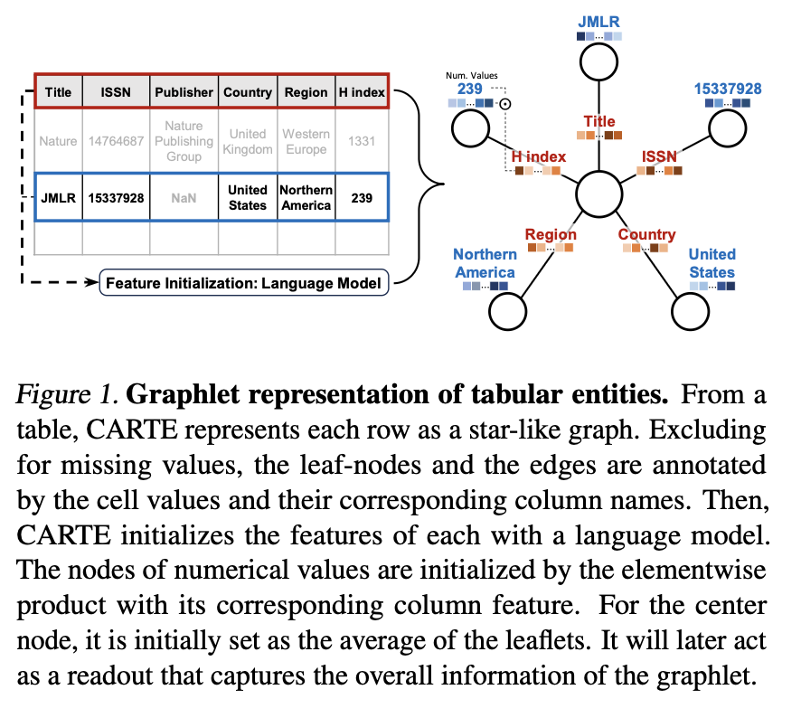
The breakthroughs
Breakthrough 2: CARTE
CARTE (Context-Aware Representation of Tabular data for Extraction)
Source: INRIA, France (May 2024) - from Gaël Varoquaux's team (of Scikit-learn fame).
The Core Idea: Don't just learn from the table; learn from the world.
CARTE enriches tabular data with real-world knowledge.
It combines a knowledge graph (YAGO3) with a graph-transformer model.
It understands that "Paris" is a city and "Tesla" is a car company.
>
Pg: 16

Slide 17
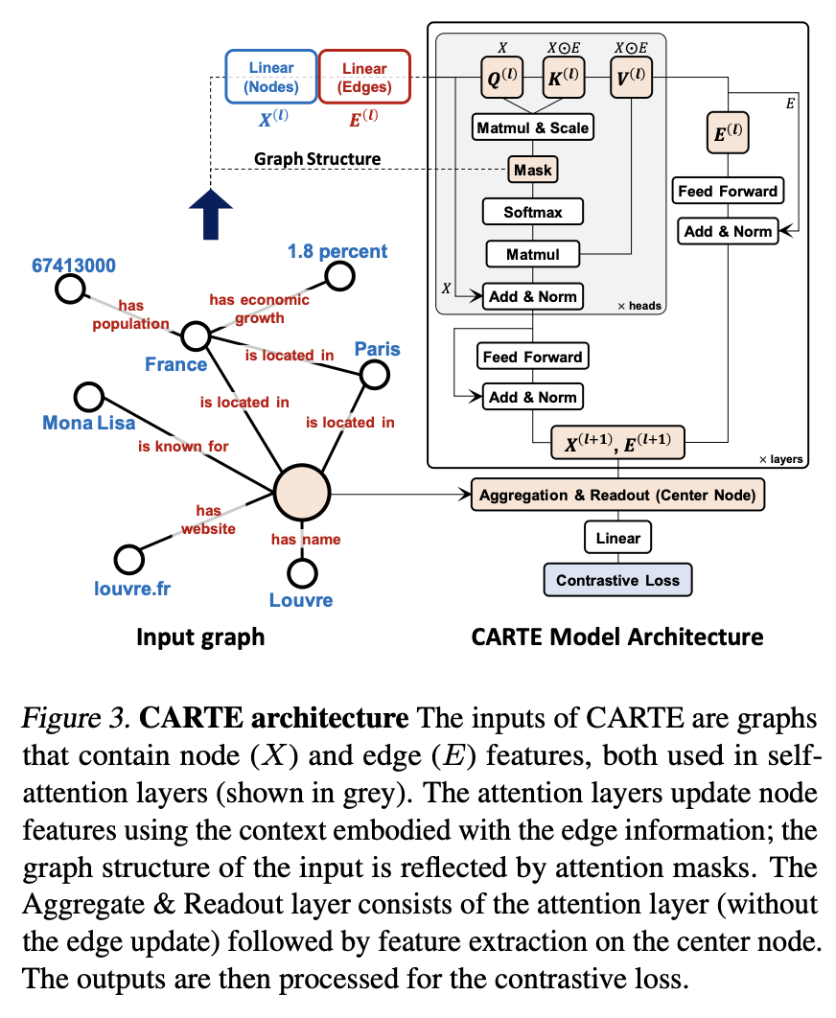
The breakthroughs
How CARTE Works
Architectural Approach:
Row to Graph: Each row in a table is converted into its own graph structure.
Contextual Embeddings: Text and categorical values are embedded using a pre-trained model to capture their semantic meaning.
Knowledge Pre-training: The model is pre-trained on YAGO3, a knowledge base with 18 million facts, allowing it to "absorb" general knowledge before seeing a specific dataset.
>
Pg: 17

Slide 18
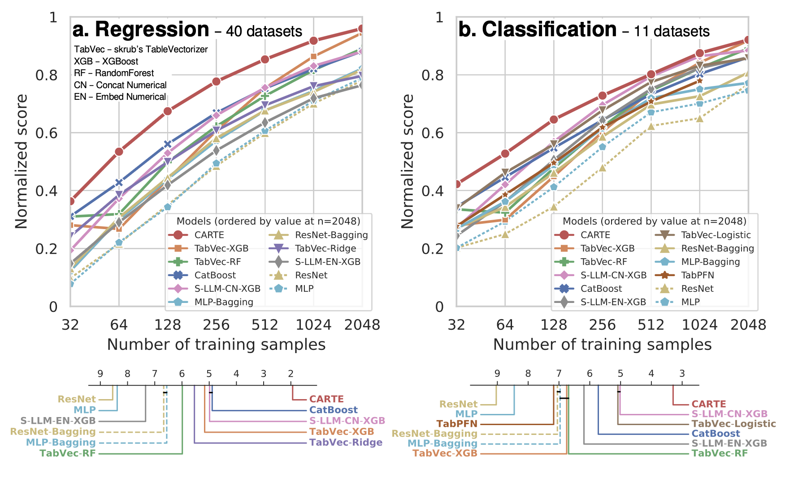
The breakthroughs
CARTE's Strengths: Handling "Messy" Real-World Data
Designed for data that breaks traditional models:
High-Cardinality Categorical Variables: Columns with thousands of unique values (e.g., product IDs, city names).
Sparse Features: Tables with many missing values ("Swiss cheese" data).
Mixed Data Types: A single table with numbers, text, dates, and categories.
Pioneers multi-table learning: Can extract insights from multiple, schema-mismatched datasets.
>
Pg: 18

Slide 19
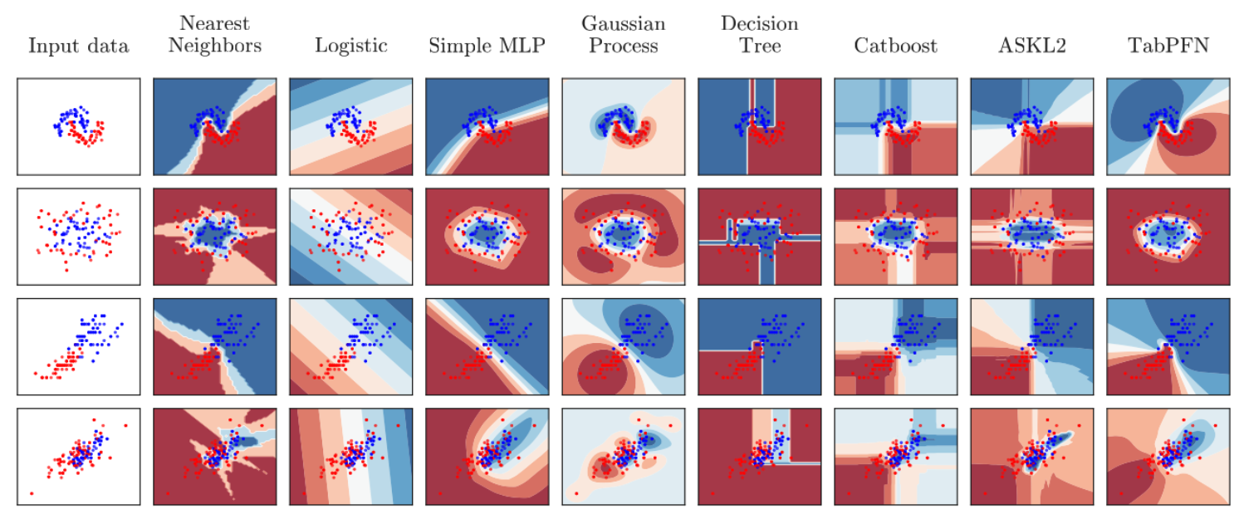
The breakthroughs
TabPFN vs. CARTE: A Simple Guide
Which Model for Which Task?
TabPFN:
Dominates purely numerical or structured datasets.
Ideal for speed and efficiency on small, clean tables.
CARTE:
Has a distinct advantage when the dataset contains rich text, categories, or named entities.
Excels where the external context is crucial for understanding the data.
>
Pg: 19

Slide 20
Section [03]: The new stuff

Slide 21
The new stuff
Relationship to CARTE: Two Paths to "Meaning"
The Next Evolution: Addressing the Scalability of ICL
Problem: TabPFN is revolutionary for small data (≤10k samples) but its architecture struggles to scale to larger datasets.
Solution: TabICL (INRIA, 2025) - A new foundation model designed for In-Context Learning on large data (up to 500k samples).
Both models come from INRIA and aim to create richer data representations.
CARTE: Finds meaning using external knowledge. It connects cell values to a real-world knowledge graph (e.g., knows "Paris" is a city).
TabICL: Finds meaning using internal knowledge. It analyzes the table's statistical structure (e.g., knows "price" is a skewed, heavy-tailed column).
>
Pg: 21

Slide 22
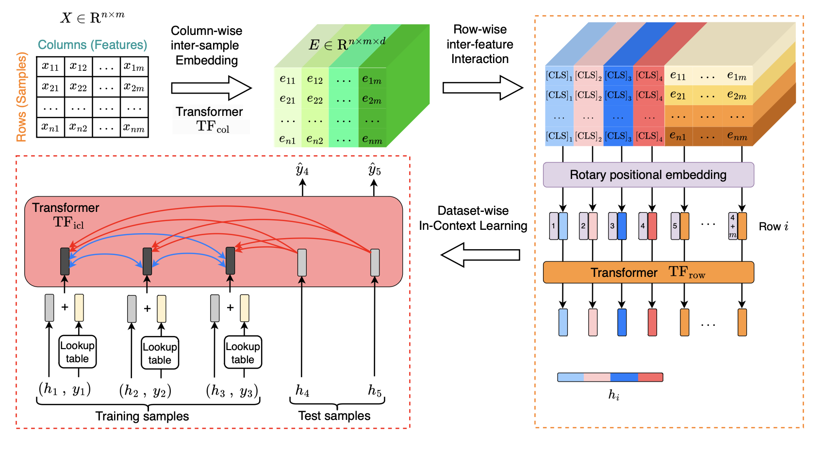
The new stuff
Scaling In-Context Learning: TabICL
Key Innovation: A Two-Stage "Embed-then-Learn" Architecture
Column-wise Embedding: Uses a Set Transformer to analyze the statistical distribution of each column and create "distribution-aware" cell embeddings.
Row-wise Interaction: Compresses the embeddings for each row into a single, fixed-size vector.
In-Context Learning: Performs ICL on the sequence of compact row embeddings, making it highly efficient.
>
Pg: 22

Slide 23
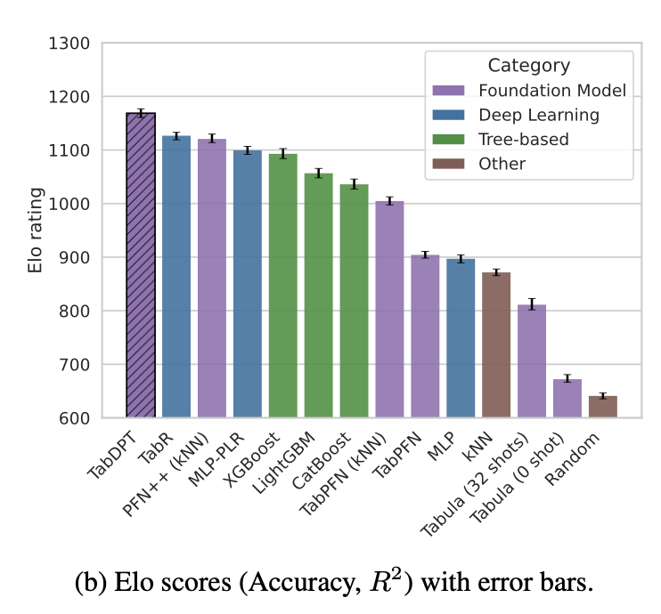
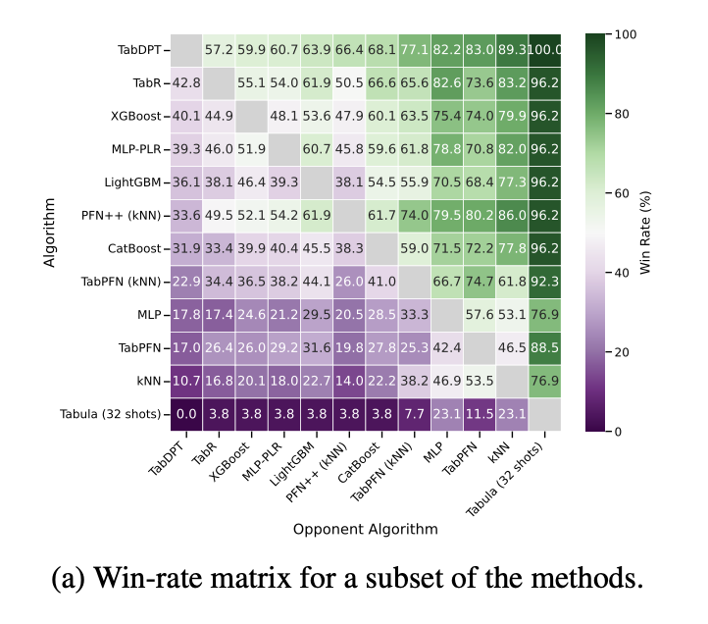
The new stuff
Another Path to Scale: TabDPT & The Power of Real Data
The Question: Is synthetic data enough? Or can we learn more from real-world tables?
TabDPT (Tabular Discriminative Pre-trained Transformer)
Core Idea: Rejects synthetic data and instead pre-trains a foundation model on a large corpus of real-world public datasets.
Key Innovations:
Self-Supervised Learning (SSL): Learns from tables by repeatedly masking a random column and training the model to predict it from the other columns.
Retrieval-based In-Context Learning (ICL): To handle large datasets, it doesn't use the whole table as context. Instead, for each test point, it finds the k-Nearest Neighbors (kNN) from the training set and uses only those as the context.
Primary Result: Demonstrates strong scaling laws. Performance predictably improves with more model parameters and, crucially, more real-world pre-training data.
>
Pg: 23

Slide 24
Section [04]: Benchmarking

Slide 25
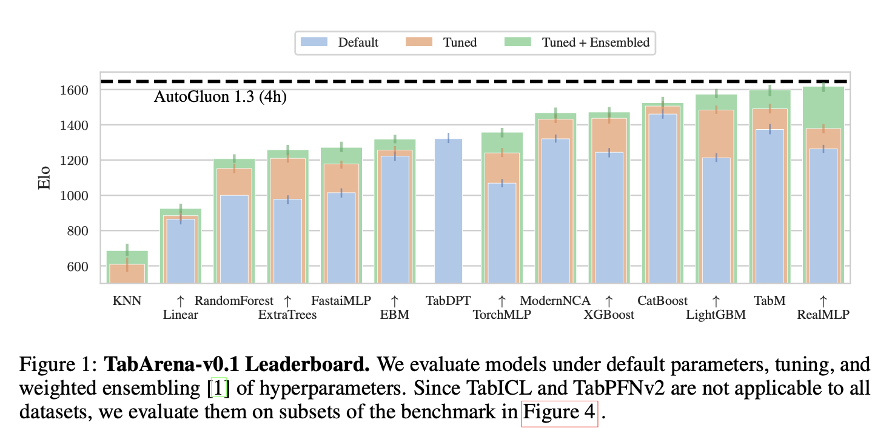
benchmarking
The Problem: Why Our Benchmarks Were Broken
The Challenge of Measuring Progress in Tabular ML
Recent research revealed major flaws in existing benchmarks:
Static & Outdated: Benchmarks aren't updated with new models or when flaws are found.
Problematic Data: Heavy use of non-IID datasets, datasets from other domains (images, text), and data with leaks.
Misleading Evaluation: Simple holdout validation underestimates actual model performance.
Solution: TabArena - A Living Benchmark
A continuously maintained system with a public leaderboard.
Manually curated 51 high-quality, real-world IID datasets.
Rigorous, fair evaluation protocols.
>
Pg: 25

Slide 26
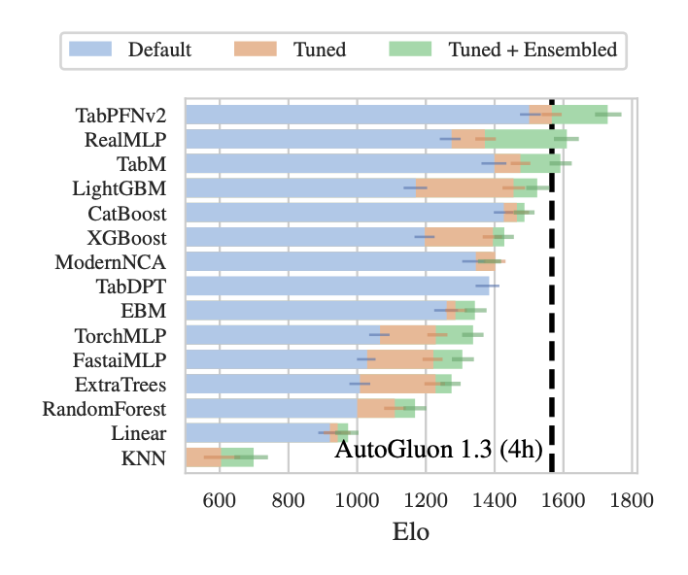
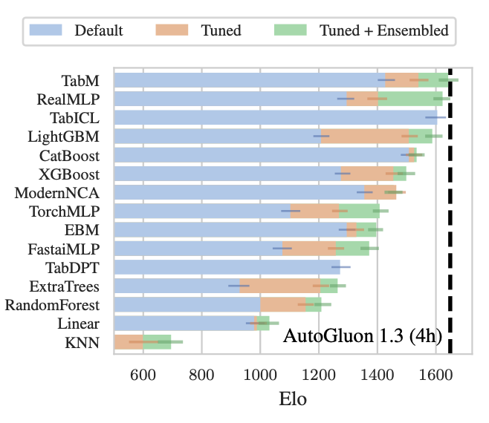
Benchmarking
TabArena's Key Findings: The New State-of-the-Art
Finding 1: Deep Learning is Now a Top Contender
With sufficient tuning time and post-hoc ensembling, the best Deep Learning models (e.g., TabM, RealMLP) are now equal to or better than top Gradient Boosted Trees (GBDTs).
Finding 2: Foundation Models Dominate on Small Data
On compatible datasets (≤10k samples), TabPFN v2 outperforms all other models, establishing itself as the go-to for the small data regime.
Finding 3: Ensembling is Key to Peak Performance
The model rankings change significantly when ensembling multiple hyperparameter configurations. This is critical for unlocking a model's full potential.
>
Pg: 26

Slide 27
Section [05]: Summing up

Slide 28

Summing up
A New Perspective: Beyond the "Trees vs. DNN" Debate
The "GBDT vs. Deep Learning" debate is a false dichotomy.
The True SOTA is a Diverse Ensemble
The single best-performing system in the benchmark is a simulated ensemble of all models in TabArena.
This pipeline outperforms any single model, including the top GBDTs and NNs.
The Future is Collaboration, Not Competition
The research goal should shift from finding a single "best" model to creating novel, diverse models that contribute unique predictive power to ensembles.
For practitioners, this reinforces the notion that using Kaggle style ensembling strategies (such as done by AutoGluon, the reference pipeline in TabArena) is the most reliable path to achieving state-of-the-art results.
>
Pg: 28

Slide 29
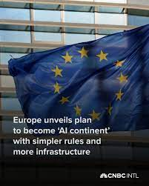
Summing up
Europe as the Hub for Tabular AI
A Surprising Geographical Trend
Much of the foundational research in this area is emerging from European labs.
Key Hubs:
Freiburg, Germany (TabPFN)
INRIA, France (CARTE)
Van der Schaar Lab, Cambridge, UK
Why Europe?
A strong academic tradition in these areas
A opportunistic because lagging behind US tech giants in GPUs and research?
>
Pg: 29

Slide 30

Summing up
The Final Frontier: Explainability, Regulation, Real World
The Challenge: The Black Box Dilemma
The most powerful new models (TabPFN, CARTE, TabICL, TabDPT) are complex transformers.
Their "black-box" nature makes it difficult to explain why a specific prediction was made.
This creates a direct conflict with the demands of EU AI Regulations and the needs of high-stakes sectors (banking, insurance, medical).
The Regulatory Mandate: Fairness, Transparency, and Controllability
For loan approvals, insurance claims, or medical diagnoses, organizations must be able to audit their models for fairness, bias, and correctness.
"The model said so" is not a legally acceptable justification.
>
Pg: 30

Slide 31

Summing up
An Alternative Path: Program Search-based AutoML
A Third Direction: Finding the Best Classical Algorithm
Concept:
Leverages an LLM's reasoning ability (similar to AlphaGeometry or FunSearch) to perform a "program search."
The LLM doesn't solve the task itself; it discovers the optimal traditional ML algorithm and hyperparameters for a given dataset.
Key Advantage: Explainability
The final output is a classical, interpretable model (e.g., a tuned XGBoost), which is critical for regulated industries like finance.
>
Pg: 31

Slide 32

Summing up
A Two-Track Future concept
A Promising Alternative: Program Search-based AutoML
Uses an LLM to discover the best classical, interpretable ML model (e.g., decision trees, linear models) for a task.
The final, deployed model is explainable by design, allowing for clear audits and bias checks that satisfy regulatory requirements.
The Outlook: A Two-Track Future for Tabular AI
Performance Track: Black-box models will dominate where peak accuracy is the sole objective and explainability is not critical.
Compliance Track: Interpretable models (like those found via Program Search) will be mandatory for high-risk, regulated applications.
James Yeung @jamesyeung18
>
Pg: 32

Slide 33
Literature
Literature
Hollmann, Noah, et al. "Tabpfn: A transformer that solves small tabular classification problems in a second." arXiv preprint arXiv:2207.01848 (2022).
Ma, Junwei, et al. "Tabdpt: Scaling tabular foundation models." arXiv preprint arXiv:2410.18164 (2024).
Qu, Jingang, et al. "Tabicl: A tabular foundation model for in-context learning on large data." arXiv preprint arXiv:2502.05564 (2025).
Erickson, Nick, et al. "TabArena: A Living Benchmark for Machine Learning on Tabular Data." arXiv preprint arXiv:2506.16791 (2025).
Van Breugel, Boris, and Mihaela Van Der Schaar. "Why tabular foundation models should be a research priority." arXiv preprint arXiv:2405.01147 (2024).
Hollmann, Noah, et al. "Accurate predictions on small data with a tabular foundation model." Nature 637.8045 (2025): 319-326.
Arik, Sercan Ö., and Tomas Pfister. "Tabnet: Attentive interpretable tabular learning." Proceedings of the AAAI conference on artificial intelligence. Vol. 35. No. 8. 2021.
Kim, Myung Jun, Léo Grinsztajn, and Gaël Varoquaux. "CARTE: pretraining and transfer for tabular learning." arXiv preprint arXiv:2402.16785 (2024).
Ye, Han-Jia, et al. "Revisiting nearest neighbor for tabular data: A deep tabular baseline two decades later." arXiv preprint arXiv:2407.03257 (2024).
Gorishniy, Yury, Akim Kotelnikov, and Artem Babenko. "Tabm: Advancing tabular deep learning with parameter-efficient ensembling." arXiv preprint arXiv:2410.24210 (2024). Ryan, M., Massaron, L. (2025). Machine Learning for Tabular Data. United States: Manning.
>
Pg: 33

Slide 34
Q&A

Slide 35
Thank You

